Slide 1
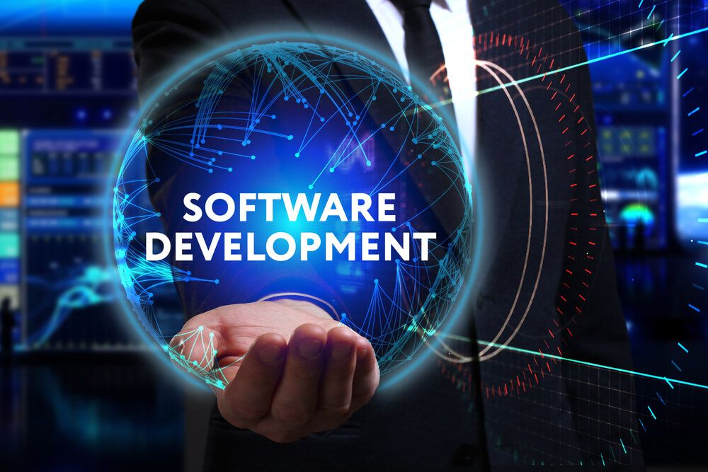

Slide 2

What is language?
Language is the medium to communicate with each other
Language helps us express our feelings and thoughts
Language is a mode of communication that is used to share ideas, opinions with each other.

Slide 3
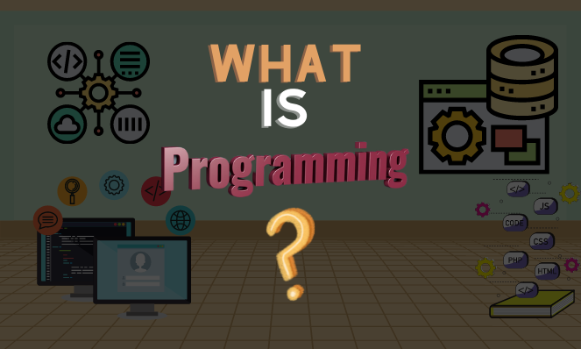

Slide 4

Programming
A program is a list of instructions that is executed by a computer to accomplish a particular task
creating those instructions is programming by a programmer

Slide 5
Flow of Programming Language
Human
Any one of the programming language(C,C++,…)
Source code
A=10;
B=20;
C=A+B;
computer
Machine code
(Os and 1s)
Translator

Slide 6
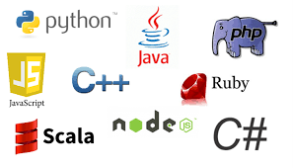
Different Programming Language

Slide 7

What is programming language?
A programming language is a computer language that is used by programmers (developers) to communicate with computers.
It is a set of instructions written in any specific language to perform a specific task.

Slide 8
Types of Programming Language
Low level Language
- Machine Level Language
- Assembly level Language
High level Language
010100011001
ADD A , B
C=A+B

Slide 9

Machine Level Language
The machine-level language is a language that consists of a set of instructions that are in the binary form 0 or 1
we knotrucw that computers can understand only machine instions, which are in binary digits, i.e., 0 and 1
So computer can directly undenstand machine level language.

Slide 10
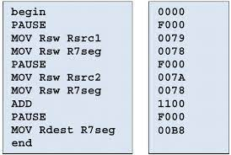
Assembly Level Language
Assembly level language is the more than low level and less than high-level language so it is intermediate language.
Assembly languages use numbers, symbols, and abbreviations instead of 0s and 1s.
So computer Can’t Directly understand by assembly level language.

Slide 11
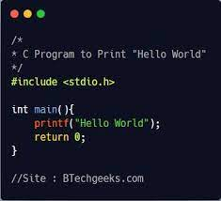
High Level Language
It is programmer friendly language.
It is easy to understand.
It is simple to debug.

Slide 12
Translator
Translator are used to Translate the One programming Language in to
Functionally equivalent of another programming Language
Types:
Compiler
Interpreter
Assembler

Slide 13
Compiler
Compiler takes the Entire program in one go.
It will show all error and warnings at the same time after compile the whole program.
It is Faster.
Compiler
Source code
Object code

Slide 14
Interpreter
Interpreter takes a single line of code at a time.
It will show one error at a time
It is Slower.
Source Code
Interpreter
Executable Code
Get Next Instruction

Slide 15
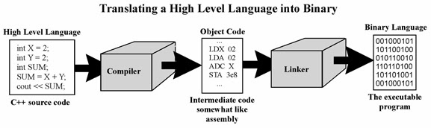
Translate High level to low level

Slide 16
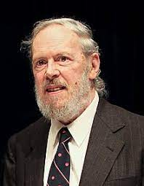
Introduction to C
C is a general-purpose programming language created by Dennis Ritchie at the Bell Laboratories in 1972.
C is a Structure Programming Language
C is a Procedural Oriented Programming Language
Mother Language

Slide 17
History of C:
ALGOL → 1960
BCPL → 1967
B → 1970
C → 1972

Slide 18
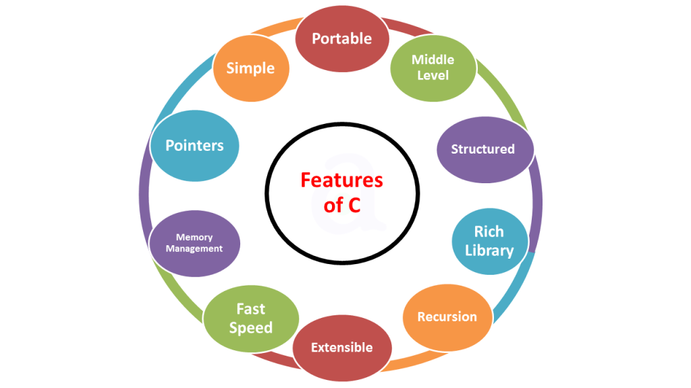
Features of c:

Slide 19
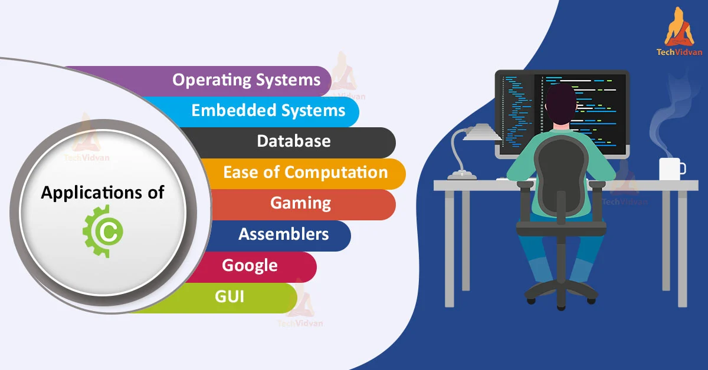

Slide 20
Hello world Program in c
#include <stdio.h>
int main() {
printf("Hello World!");
return 0;
}
OUTPUT:
Hello World

Slide 21


